Slide 1
LITERATURE UNDERSTANDING

Slide 2
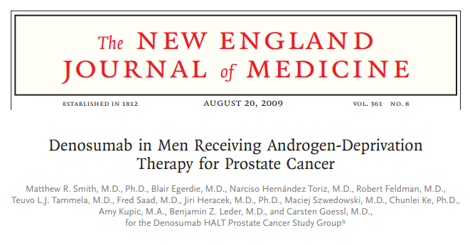
1

Slide 3
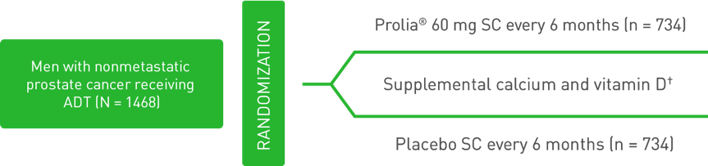
Study Design
Randomized, multinational, double-blind, phase 3 study assessing the effects of Denosumab vs placebo on BMD and new vertebral fractures
Denosumab
1. Denosumab® (denosumab) prescribing information
5. N Engl J Med. 2009;361:745-755.
6. Lancet. 2015;386(9992):433-443.

Slide 4
Inclusion Criteria:
Men were stratified according to
Duration of androgen-deprivation therapy (ADT) ( 6 months or > 6 months) and
Age ( 70 years or < 70 years).
Men less than 70 years of age had either a
BMD T-score at the lumbar spine, total hip, or femoral neck between –1.0 and –4.0, or
A history of an osteoporotic fracture.
Patients were instructed to take
1000 mg of calcium and
400 IU of vitamin D supplementation daily.
1. Denosumab® (denosumab) prescribing information
5. N Engl J Med. 2009;361:745-755.
6. Lancet. 2015;386(9992):433-443.

Slide 5
Endpoints
Primary Endpoint:
Percent change in: Lumbar spine BMD from baseline to 24 months
Secondary Endpoints:
Incidence of: Newly diagnosed vertebral fracture through 36 months
Percent change in:
Lumbar spine BMD from baseline to 36 months
Total hip BMD from baseline to 36 months
Femoral neck BMD from baseline to 36 months
1. Denosumab® (denosumab) prescribing information
5. N Engl J Med. 2009;361:745-755.
6. Lancet. 2015;386(9992):433-443.

Slide 6
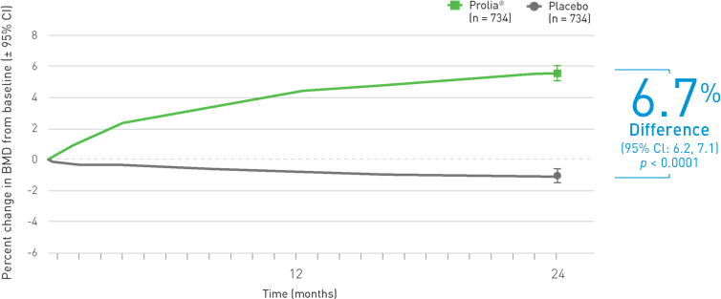
Efficacy: At 24 Month A significant increase in BMD at the lumbar spine compared with placebo (p < 0.0001; Primary Endpoint)
At 24 months, bone mineral density of the lumbar spine had increased by 5.6% in the Denosumab group as compared with a loss of 1.0% in the placebo group
The Bone Mineral Density At The Lumbar Spine Was Increased By
Mean percent change in BMD at 24 months
Denosumab
1. Denosumab® (denosumab) prescribing information
5. N Engl J Med. 2009;361:745-755.
6. Lancet. 2015;386(9992):433-443.

Slide 7
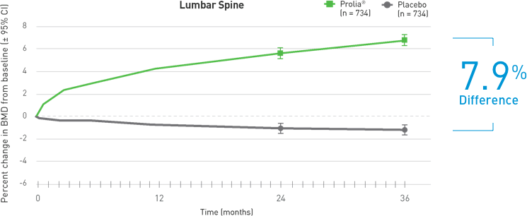
Efficacy: At 36 Months Denosumab demonstrated a continued increase in BMD through 36 months (Secondary Endpoint)
LUMBAR SPINE
Mean percent change in BMD at 36 months
1. Denosumab® (denosumab) prescribing information
5. N Engl J Med. 2009;361:745-755.
6. Lancet. 2015;386(9992):433-443.

Slide 8
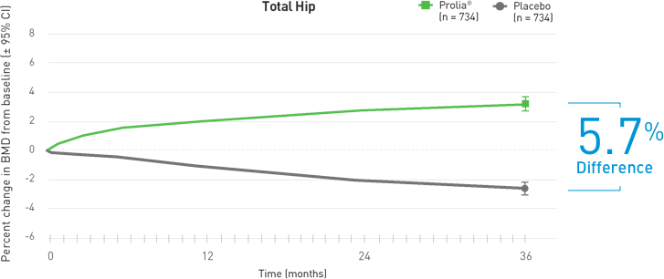
Efficacy: At 36 Months Denosumab demonstrated a continued increase in BMD through 36 months (Secondary Endpoint)
TOTAL HIP
Mean percent change in BMD at 36 months
1. Denosumab® (denosumab) prescribing information
5. N Engl J Med. 2009;361:745-755.
6. Lancet. 2015;386(9992):433-443.

Slide 9
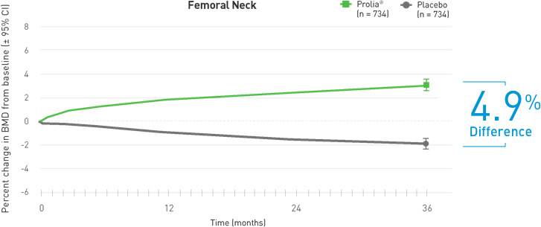
Efficacy: At 36 Months Denosumab demonstrated a continued increase in BMD through 36 months (Secondary Endpoint)
FEMORAL NECK
Mean percent change in BMD at 36 Months
1. Denosumab® (denosumab) prescribing information
5. N Engl J Med. 2009;361:745-755.
6. Lancet. 2015;386(9992):433-443.

Slide 10
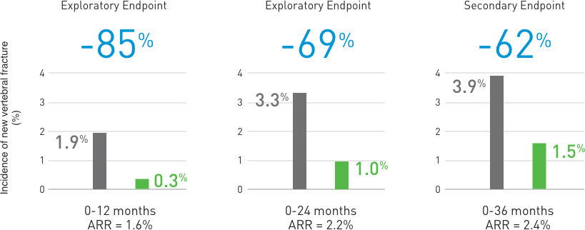
New Fracture: Denosumab sustained reduction of new vertebral fractures up to 36 months ⁶
Denosumab significantly decreased the incidence of new vertebral fractures up to 36 months ^{1,6}
Relative risk reduction of new vertebral fracture at 12, 24, and 36 months ^{1,5}
62% Relative Risk Reduction in the incidence of new vertebral fractures at 36 months* ¹
ARR = Absolute Risk Reduction.
1. Denosumab® (denosumab) prescribing information
5. N Engl J Med. 2009;361:745-755.
6. Lancet. 2015;386(9992):433-443.

Slide 11
Safety And Tolerability
Adverse Events (10% Frequency In Each Treatment Group)¹
 | Placebo (n = 725) | Denosumab (n = 731)
Arthralgia | 11.0% | 12.6%
Back pain | 10.2% | 11.1%
Constipation | 10.3% | 10.0%
Denosumab has been studied in a clinical trial of 1468 men with prostate cancer on ADT.⁵
The overall incidence of adverse events was similar between Denosumab and placebo (both approximately 87%).⁵
1. Denosumab® (denosumab) prescribing information
5. N Engl J Med. 2009;361:745-755

Slide 12
Safety And Tolerability
Pain in extremity and musculoskeletal pain have also been reported in clinical trials¹
The percentage of patients who withdrew from the study due to adverse events :
7.0% and 6.1% for the Denosumab and placebo groups, respectively¹
Overall rates of serious adverse events
34.6% and 30.6%, between Denosumab and placebo respectively¹
1. Denosumab® (denosumab) prescribing information
5. N Engl J Med. 2009;361:745-755

Slide 13
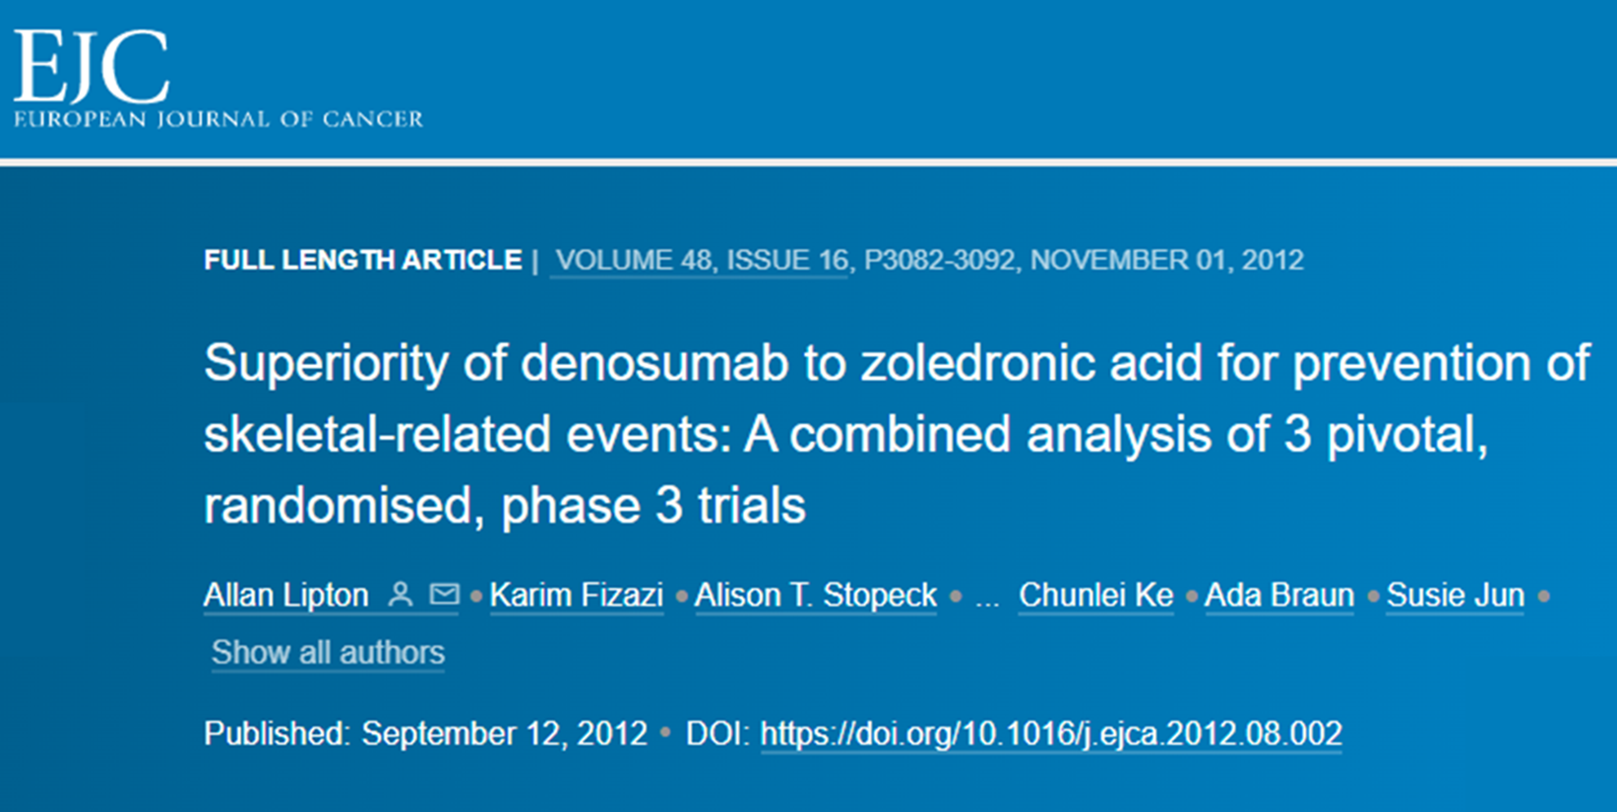
2

Slide 14
Phase 3, double-blind, double-dummy, active-controlled trials in patients with bone metastases from solid tumors (Denosumab ®: n=2,862; ZA: n=2,861)
Intervention: Patients were randomized 1:1 to receive Denosumab 120 mg SC Q4W or ZA 4 mg IV Q4W
Per label, ZA was dose-adjusted for baseline creatinine clearance ≤60 mL/min
No dose adjustments were made and no doses were withheld for increased serum creatinine for Denosumab
2. Eur J Cancer. 2012;48(16):3082-3092.

Slide 15
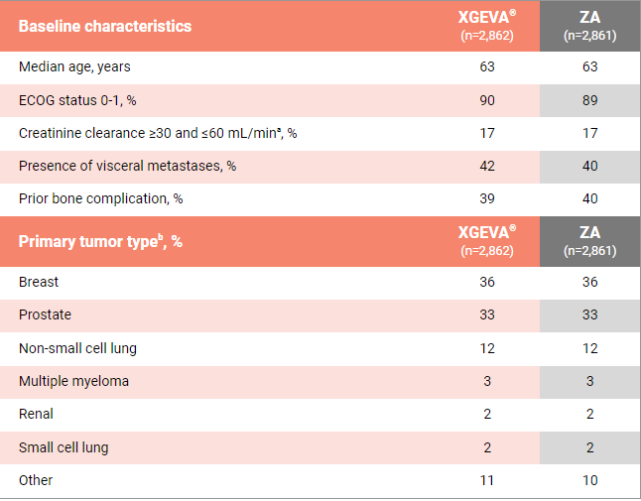
Endpoints & Demographics
Primary Endpoints: Time to first bone complication as compared with ZA
Secondary Endpoint : Time to first bone complication (superiority)

Slide 16
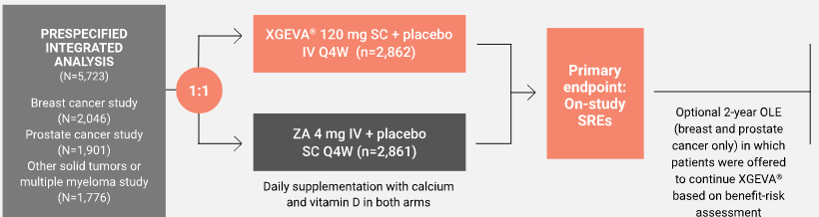
Study Schema
Evaluated in 3 identically designed head-to-head studies vs ZA + 2-year OLE phase ^{2,3}
OLE, open-label extension
2. Eur J Cancer. 2012;48(16):3082-3092.
3. Support Care Cancer. 2016;24(1):447-455.

Slide 17
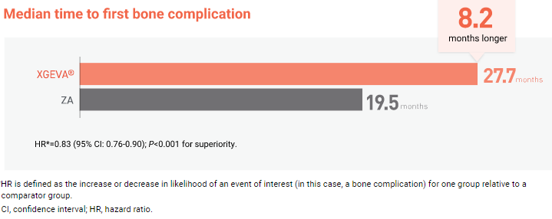
Result: SRE Prevention
Denosumab was superior to zoledronic acid in delaying time to first on-study SRE by a median 8.21 months,
Denosumab was superior to zoledronic acid in preventing SRE with favourable safety and convenience in patients with bone metastases from advanced cancer.
2. Eur J Cancer. 2012;48(16):3082-3092.

Slide 18
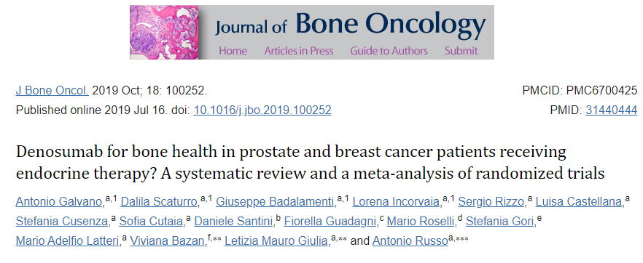
3

Slide 19
Aim
This pre-planned analysis evaluates the efficacy and safety of denosumab versus zoledronic acid across three pivotal studies.
2. Eur J Cancer. 2012;48(16):3082-3092.

Slide 20
Aim
To compare studies of men with prostate cancer receiving ADT and women with breast cancer following adjuvant endocrine therapy in order to evaluate the effects of Denosumab in terms of
BMD increase at 24 and 36 months,
The BMD loss,
The reduction of fractures risk (in particular vertebral fractures) at 24 and 36 months and
Safety (overall, serious adverse events – SAEs and discontinuation rate).
J Bone Oncol. 2019 Oct; 18: 100252.

Slide 21
Study Design
RCT’s included: 3
Trials with sample size more than 10
Prostate cancer patients
Patients were treated with ADT
Denosumab at the dose of 60 mg every six month or placebo.
J Bone Oncol. 2019 Oct; 18: 100252.

Slide 22
Result
Reduction of the BMD loss up to 36 months both at the lumbar and femoral level
BMD increase both at 24 and 36 months.
Reduction in the number of new vertebral and femoral fractures at 24 and 36 months.
Denosumab did not affect both the SAEs and therapy discontinuation risk.
J Bone Oncol. 2019 Oct; 18: 100252.

Slide 23
Conclusion
Denosumab administration can be considered effective and safe in the prevention and management of the above mentioned adverse events related to hormonal therapies designed for breast and prostate tumours.
J Bone Oncol. 2019 Oct; 18: 100252.

Slide 24
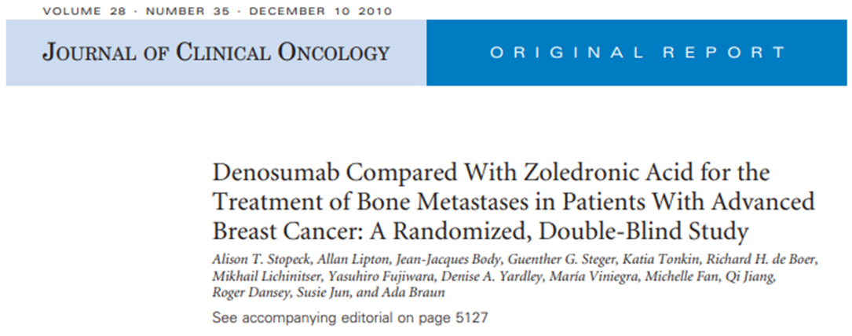
4

Slide 25
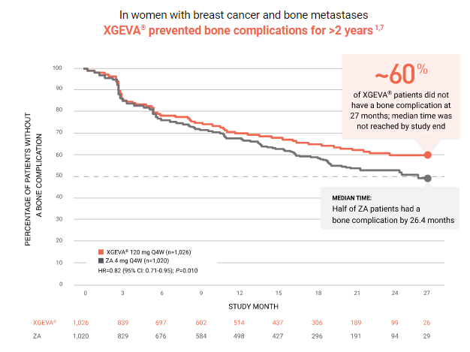
RESULT
Breast cancer with bone metastases
Journal of Clinical Oncology 28, no. 35 (December 10, 2010) 5132-5139

Slide 26
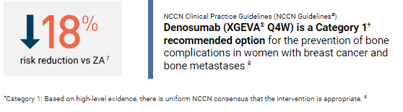
Result
Denosumab was superior to zoledronic acid in delaying or preventing SREs in patients with breast cancer metastatic to bone and was generally well tolerated.
With the convenience of a subcutaneous injection and no requirement for renal monitoring, denosumab represents a potential treatment option for patients with bone metastases

Slide 27
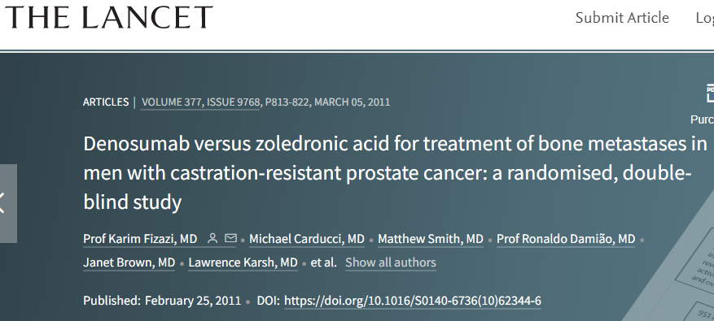
5

Slide 28
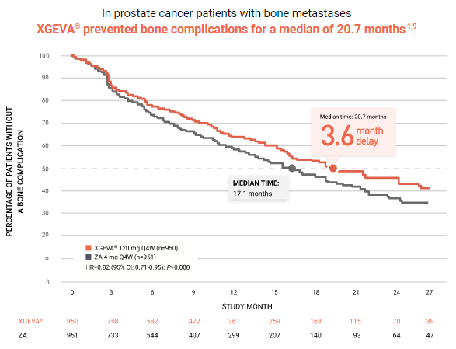
RESULT
Prostate cancer with bone metastases
Lancet. 2011;377(9768):813-822

Slide 29
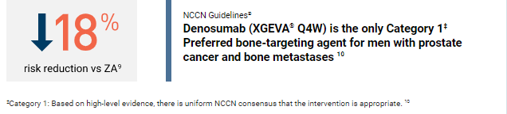
Result
Denosumab was better than zoledronic acid for prevention of skeletal-related events, and potentially represents a novel treatment option in men with bone metastases from castration-resistant prostate cancer.
Lancet. 2011;377(9768):813-822

Slide 30
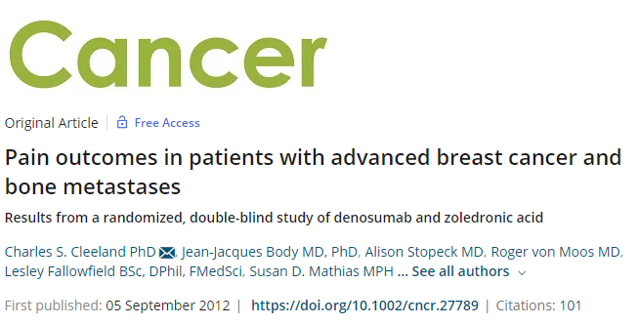
5

Slide 31
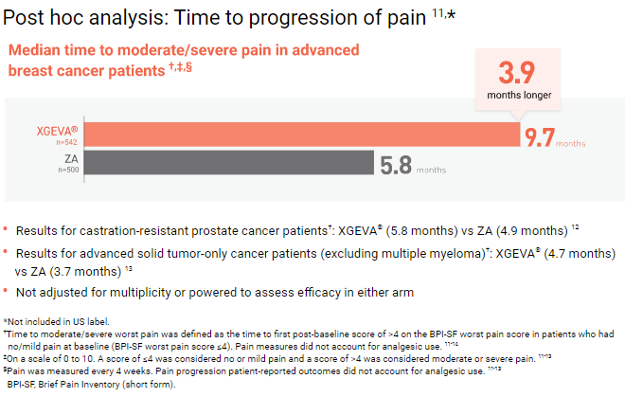
RESULT
Bone Pain
Cancer. 2013;119(4):832-838.

Slide 32
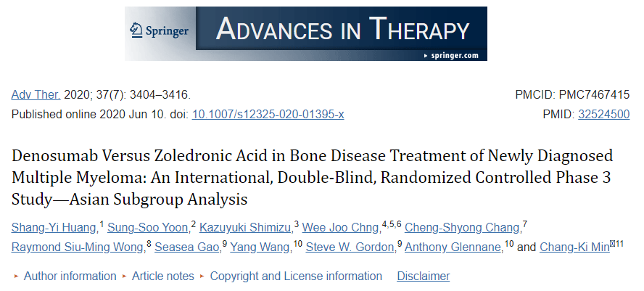
6

Slide 33
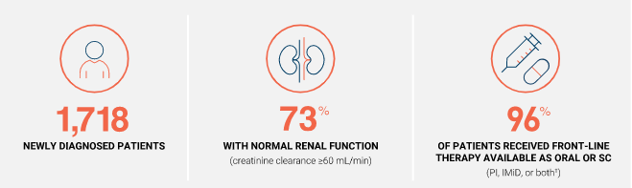
Denosumab was studied in a broad range of newly diagnosed patients¹
Lancet Oncol. 2018;19(3):370-381.

Slide 34
Intervention
In this 4-year, phase 3 study, patients were randomized 1:1 to receive
Either Denosumab 120 mg by SC injection Q4W and a placebo by IV infusion (n=859) or
ZA 4 mg by IV infusion over 15 minutes, Q4W, and a placebo by SC injection (n=859).
Both arms received daily supplements of calcium and vitamin D. ^{1-3,‡}
Lancet Oncol. 2018;19(3):370-381.

Slide 35
No SC dose adjustments were required for administering Denosumab ¹
ZA was dose adjusted for baseline creatinine clearance and subsequent dose intervals were determined by serum creatinine levels 2,4
Patients with creatinine clearance <30 mL/min were not included in the clinical trial¹
Primary endpoint: Time to first on-study bone complication (noninferiority analysis).¹
Lancet Oncol. 2018;19(3):370-381.

Slide 36
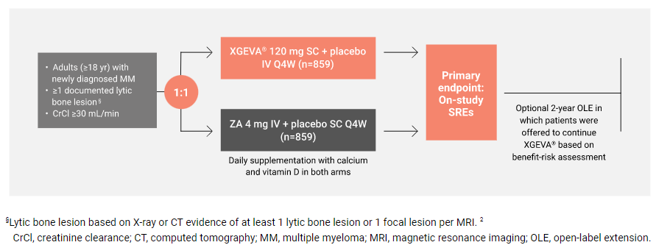
Study Design
Evaluated in a phase 3 head-to-head study vs ZA + 2-year OLE phase ^{2,3}
Lancet Oncol. 2018;19(3):370-381.

Slide 37
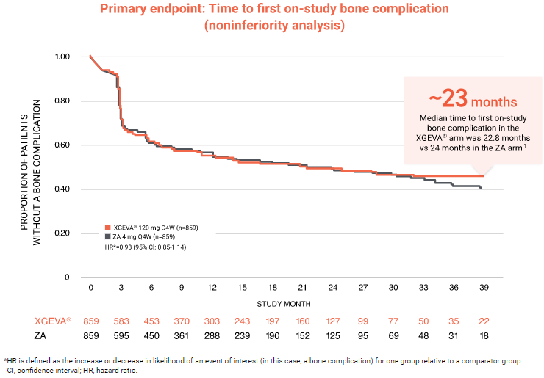
XGEVA® provided nearly 23 months of prevention ^{1,2}
Lancet Oncol. 2018;19(3):370-381.

Slide 38
Summary
TRIAL | PUBLICATION & YEAR | AUTHOR | INDICATION | RESULT | CONCLUSION
Denosumab in men receiving Androgen deprivation therapy for prostate cancer | N Engl J Med. 2009;361:745-755. | Matthew R. Smith et.al | for bone health in prostate and breast cancer patients receiving endocrine therapy (Solid Tumors) | At 24 months, BMD of the LS had increased by 5.6%. Decreased incidence of new vertebral fractures at 36 months with Denosumab. | Denosumab was associated with increased bone mineral density at all sites and a reduction in the incidence of new vertebral fractures among men receiving ADT
Superiority of denosumab to zoledronic acid for prevention of skeletal-related events: a combined analysis of 3 pivotal, randomised, phase 3 trials | Eur J Cancer .2012Nov;48(16): 3082-92 | Allan Lipton , et.al | prevention of skeletal-related events In Solid Tumors | Denosumab was superior to zoledronic acid in delaying time to first on-study SRE by a median 8.21 months, | Denosumab was superior to zoledronic acid in preventing SRE with favourable safety and convenience in patients with bone metastases from advanced cancer.
Lancet Oncol. 2018;19(3):370-381

Slide 39
Summary
TRIAL | PUBLICATION & YEAR | AUTHOR | INDICATION | RESULT | CONCLUSION
Denosumab for bone health in prostate and breast cancer patients receiving endocrine therapy? A systematic review and a meta-analysis of randomized trials | J Bone Oncol. 2019 Oct; 18: 100252. | Antonio Galvano et.al | Osteoporosis in men receiving Androgen deprivation therapy for Non Metastatic prostate cancer | Reduction of the BMD loss up to 36 months both at the lumbar and femoral level BMD increase both at 24 and 36 months. Reduction in the number of new vertebral and femoral fractures at 24 and 36 months. Denosumab did not affect both the SAEs and therapy discontinuation risk. | Denosumab administration can be considered effective and safe in the prevention and management of the above mentioned adverse events related to hormonal therapies designed for breast and prostate tumours
Denosumab compared with zoledronic acid for the treatment of bone metastases in patients with advanced breast cancer: a randomized, double-blind study | J Clin Oncol . 2010 Dec 10;28(35):5132-9. | Alison T Stopeck, et.al | prevention of skeletal-related events In Solid Tumors | Approx 60 % of Patients on Denosumab does not have complication at 27 month | Denosumab was better than zoledronic acid for prevention of skeletal-related events, and potentially represents a novel treatment option in men with bone metastases from castration-resistant prostate cancer.
Lancet Oncol. 2018;19(3):370-381

Slide 40
Summary
TRIAL | PUBLICATION & YEAR | AUTHOR | INDICATION | RESULT | CONCLUSION
Denosumab versus zoledronic acid for treatment of bone metastases in men with castration-resistant prostate cancer: a randomised, double-blind study | Lancet . 2011 Mar 5;377(9768):813-22. | Karim Fizazi. et.al | bone metastases in men with castration-resistant prostate cancer: | Prevented bone complications for a median of 20.7 months | Denosumab was better than zoledronic acid for prevention of skeletal-related events, and potentially represents a novel treatment option in men with bone metastases from castration-resistant prostate cancer
Pain outcomes in patients with advanced breast cancer and bone metastases: results from a randomized, double-blind study of denosumab and zoledronic acid | Cancer . 2013 Feb 15;119(4):832-8. | Charles S Cleeland, et.al | Advanced breast cancer and bone metastases | Results for castration-resistant prostate cancer patients†: XGEVA® (5.8 months) vs ZA (4.9 months) 12 Results for advanced solid tumor-only cancer patients (excluding multiple myeloma)†: XGEVA® (4.7 months) vs ZA (3.7 months) | Denosumab demonstrated improved pain prevention and comparable pain palliation compared with ZA. In addition, fewer denosumab-treated patients shifted to strong opioid analgesic use.
Lancet Oncol. 2018;19(3):370-381

Slide 41
Summary
TRIAL | PUBLICATION & YEAR | AUTHOR | INDICATION | RESULT | CONCLUSION
Denosumab versus zoledronic acid for treatment of bone metastases in men with castration-resistant prostate cancer: a randomised, double-blind study | Lancet . 2011 Mar 5;377(9768):813-22. | Raje N. et.al | bone Diseases with multiple Myeloma | XGEVA® provided nearly 23 months of prevention | Efficacy and safety outcomes from this Asian subgroup were comparable to those of the full study population. Overall, this analysis supports denosumab as an additional treatment option for standard of care for Asian patients with newly diagnosed MM with lytic bone lesions.
Lancet Oncol. 2018;19(3):370-381

Slide 42
Section 7: FAQ

Slide 43
Is Denosumab a chemotherapy drug?
No. Denosumab is not a chemotherapy drug.
It is a targeted treatment, called a monoclonal antibody and is classified as a bone-modifying agent.
Although it is not a chemotherapy drug it is often given with chemotherapy medicines.

Slide 44
Does Denosumab increase bone density in Patients with Prostate Cancer?
Yes, denosumab does increase bone density.
Denosumab significantly increased BMD at all clinical sites measured, relative to treatment with placebo at 3 years:
7.9% at the lumbar spine, 5.7% at the total hip, 4.9% at the femoral neck, 6.9% at the hip trochanter, 6.9% at the distal 1/3 radius and 4.7% at the total body (all p < 0.0001).
In a prospectively planned exploratory analysis, significant increases in BMD were observed at the lumbar spine, total hip, femoral neck and the hip trochanter 1 month after the initial dose

Slide 45
Does Denosumab increase the risk of new Fracture in Patients with Prostate Cancer?
NO. reversely Denosumab demonstrated a significant relative risk reduction of new vertebral fractures:
85% (1.6% absolute risk reduction) at 1 year,
69% (2.2% absolute risk reduction) at 2 years and
62% (2.4% absolute risk reduction) at 3 years (all p < 0.01).

Slide 46
How long should you take Denosumab for?
Denosumab is meant to be taken long-term.
Efficacy and safety of Denosumab once every 6 months for 3 years were investigated in men with histologically confirmed non-metastatic prostate cancer receiving ADT
However, Denosumab should be discontinued if you experience intolerable side effects or serious side effects such as osteonecrosis of the jaw or osteomyelitis, or if Denosumab appears to be ineffective for you.
There have been reports of a higher risk of multiple vertebral fractures and hypercalcemia (high calcium levels) occurring within the first year following discontinuation of Denosumab.
Patients should be monitored for both conditions when Denosumab is stopped.

Slide 47
Does Denosumab weaken your immune system?
Yes, Denosumab (denosumab) does appear to weaken your immune system.
Research has shown people who take Denosumab are at an increased risk of serious infections leading to hospitalizations, including serious infections of the skin, abdominal, urinary tract, and ear.
People administered concomitant immunosuppressant agents (such as prednisone or cyclosporine) or with impaired immune systems may be at an even higher risk.
RANKL and RANK are also expressed in cells of the immune system, including activated T lymphocytes, B cells, and dendritic cells.
This implies that inhibition of RANKL by Denosumab might alter a person’s immune function and increase their susceptibility to infections.

Slide 48
Does Denosumab cause bone pain?
Denosumab may cause pain in the bones, muscles, and joints.
Pain in the bones, joints, or muscles may start soon after treatment or many months later, but usually in the first year of taking Denosumab.
This pain may be severe and decrease your quality of life or it may be mild and barely noticeable.
Research has shown that for most patients, Denosumab is more effective than zoledronic acid at extending the bone pain-free interval.
Overall across several different cancer types, Denosumab extended the pain-free interval by 1.8 months.

Slide 49
Does Denosumab cause low blood pressure?
Low blood pressure is not a common side effect of Denosumab;
However, it may occur in people who are allergic to Denosumab alongside other allergy symptoms such as facial and throat swelling and tightness, shortness of breath, and a rash.

Slide 50
Does Denosumab cause weight gain?
Denosumab has not been associated with weight gain in clinical studies.
In studies, peripheral edema (fluid retention in the areas like the arms or legs) was reported in 4.9% of patients compared to 4% receiving a placebo
Denosumab can cause peripheral edema (fluid retention) or swelling, and this may lead to weight gain in some people.

Slide 51
Summary
Denosumab
Is not a chemotherapy drug.
Increase bone density in prostate cancer patients with bone loss associated with ADT
Demonstrated a significant relative risk reduction of new vertebral fractures
Is meant to be taken long-term_ Efficacy and safety investigated for 3 years
Does appear to weaken immune system _ May increase susceptibility to infections.
Does not have effect on Blood pressure
Not been associated with weight gain

Slide 52
Thank you

